Slide 1
Ray Tracing
By: Jacob Barnett

Slide 2
Introduction
What is ray tracing?
Ray tracing is an advanced rendering technique that generates a desired image by tracing the path of light as pixels in a given image plane.
Ray tracing tries to make light in graphics behave as is does in real life. Typically, complex algorithms will try to simulate light rays by by tracing a path that light would take in the real world and then translating this path to the image we are trying to create. The goal of ray tracing is to create a more realistic environment than what a traditional static lightning method would produce.

Slide 3
Background
Ray tracing first came about in the 1960s. Traditionally, it was used primarily in the film industry and for animation to create realistic lighting and shadows. The earlier films that used ray tracing only implemented it for part of the scene because it was very difficult at the time to create all lighting and shading with ray tracing. The large scale global illumination was faked with separate lighting techniques as well as using ray tracing for some portions of the image.
As technology advanced and progress was made in the fields of photorealistic computer graphics rendering, optical design and analysis, and radiation transfer, it made it much easier to implement ray tracing into computer animation for films. In 2013, the first animated film (Pixar’s Monster University) was created that used ray tracing for all of its lighting and shading.

Slide 4
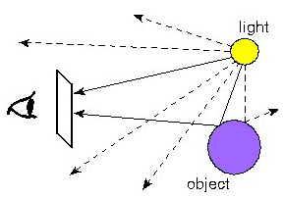
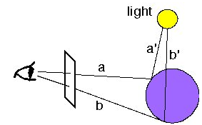
How Does Ray Tracing Work?
Ray tracing works by tracing the light rays “backwards” from their destination (the viewing port -- or what you’re looking at) to their source (the origin of the light). It works this way because we only want to trace the rays that are guaranteed to travel from the light source to their destination. If we were to try to do this by tracing rays from their source to their destination, we would have to make many calculation to find which rays we actually care about (the ones that are going to reach our viewing port).
What if the ray bounces off of many objects?
Then we want to create a Single new line for each time it bounces. Thus, this limits the amount of data that has to be computed.

Slide 5
Applications of Ray Tracing
As I have stated previously, ray tracing has been commonly used in animated films (non-real-time) for the past 50. Along with animated films, ray tracing has just recently made an emergence in the video game (real-time) industry. Currently, ray tracing only works on PCs and video game consoles with highly capable graphics cards at the moment. Although, it is starting to be streamlined into Microsoft and Sony next generation consoles. Other current applications of ray tracing include:
Architectural drawings and renderings
Utilizing global illumination for engineering (solar energy research/lighting design)
Medical visualization
Physically based rendering
Theater and television lighting design

Slide 6
Summary
Ray tracing has had great impact on the animation film industry and is just starting to impact many other fields in today’s world. With the constant growth in new technologies, ray tracing is bound to make new an stunning breakthroughs in computer graphics.
Non-real-time ray tracing (ray tracing used in animation and movies) has been around for about 50 or so years and is pretty well established. There have been many animated film and short animations that either implement some ray tracing or use ray tracing for all of the lighting and shading.
Real-time ray tracing is a somewhat new emergence, which is primarily used in video games. It is just now being implemented into new gaming systems and used with new graphics cards like Nvidia’s new RTX line. Real-time ray tracing is somewhat still temperamental at the moment, but it will only be a matter of a few years until ray tracing is the standard for all real-time computer graphics.

Slide 7
Questions and Answers
Did you have enough background to understand the paper?
Yes, I believe that I did have enough background to understand the basics of ray tracing. After learning about the different types of lighting and shading in this course, it made it fairly easy to understand what was going on.
Do you have enough background to use the techniques or to apply the paper?
No, I don’t think that I have enough background to go out and apply the techniques of ray tracing. It was pretty easy to understand the basics, but I don’t think that I have enough background to implement the complex calculations and algorithms used with ray tracing.

Slide 8
Thank You!

